Slide 1
Metal Detection Robot

Slide 2
Objective
The purpose of this project is to develop an metal detection system that allows operator to perform metal detection remotely.

Slide 3

Project Description
Underground metal detection today either for mine detection or treasure hunt involved close-by human intervention.
While the modern metal detector is already well design, it required direct human involvement.
This is rather dangerous and time consuming

Slide 4
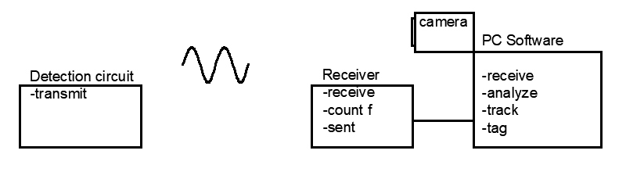
System Overview
Detection Circuit utilizes LC tank to continuously transmitting a signal
Frequency of signal to be received and measured by an remote receiver
The receiver will send frequency value to the PC via serial communication port for further processing

Slide 5
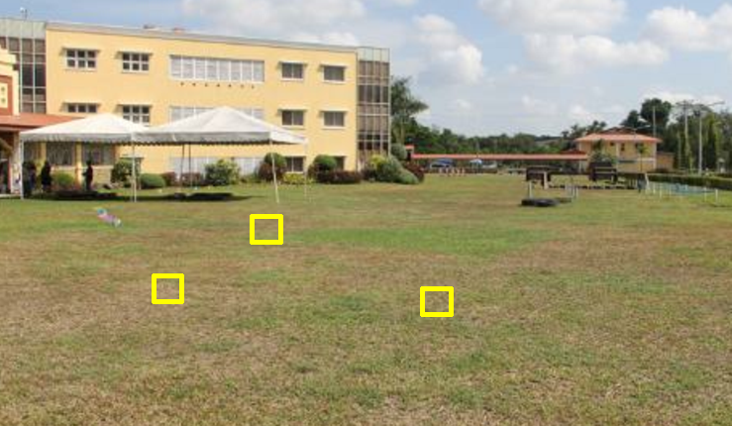
Example of the resulting image
The yellow box indicates the location at where the detector has detected metal.

Slide 6
Specifications
Max. Operation Range: 30ft
Max. Detection Distance: 10cm
Min. Metal Size : Size of a US Quarter
Max. Tracking Delay: 1 second

Slide 7
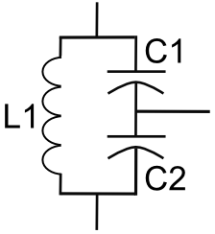
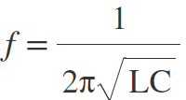
Technical Detail - Metal Detection Circuit
Circuit on the left shows a typical LC tank circuit.
The current discharged from the serial capacitors flows through the inductor, when the capacitor is fully discharged, the inductor begin to discharge to maintain the current flow, thus charging the capacitor. Process repeats resulting in oscillation
Let C1=C2=0.1uF =>C = 0.05uF
L1 = 1mH
f=1/(2*3.14*sqrt(0.05*10^-6*10^-3))
= 22kHz (base frequency)

Slide 8
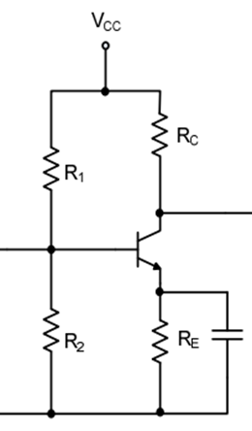
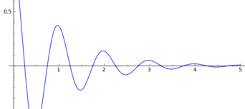
Technical Detail - Metal Detection Circuit continuous
In real life, oscillation dies out almost instantaneously
BJT Amplifier added to continuously add gain to the oscillation
Common emitter amplifier

Slide 9
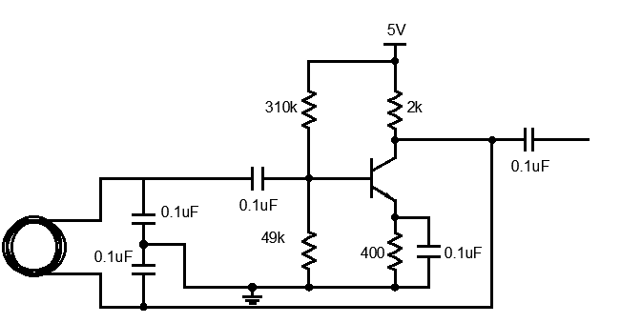
Technical Detail - Metal Detection Circuit continuous
Complete metal detection circuit
For Colpitts oscillator to start, Voltage gain must be greater than C2/C1 of the LC tank.
Design a common emitter with gain of 5.
w. B=100
Rc = 400 Ω , Re= 2000 Ω
R1 = 310k Ω , R2 = 49k Ω

Slide 10
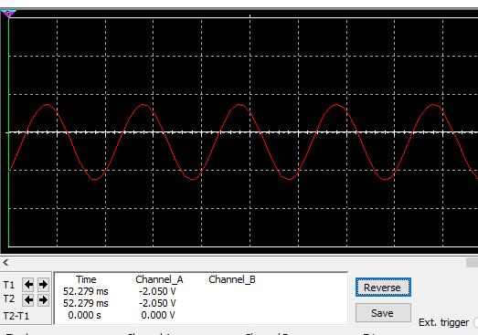
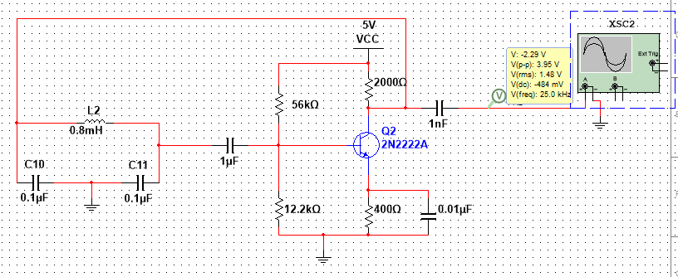
Technical Detail - Metal Detection Circuit continuous
Simulation

Slide 11


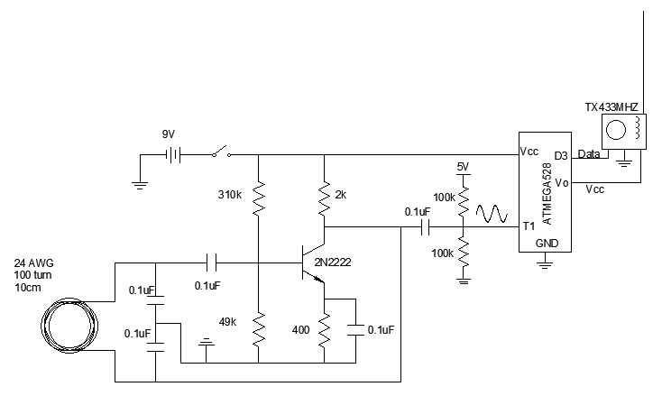



Technical Detail - Metal Detection Schematic
T0

Slide 12
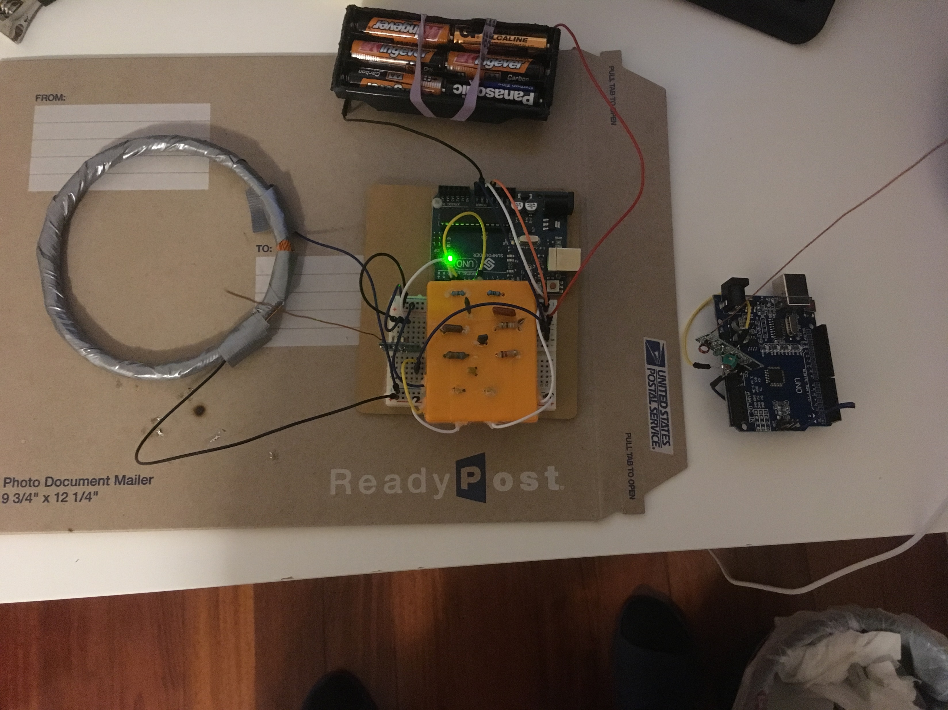
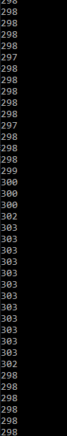
<

Slide 13
Frequency Reading– Time counter interrupt logic flow
Set external clock input on T0 and rising edge detect.
detect.
Read CPU running time = micros()
Set OCR1A = 5000
OCR1A decrements by 1 for every cycle
Set TCCR1B = 0b00000111;
Set TIMSK1 |= (1 << OIE1A );
No
Yes
OCR1A = 0?
Current CPU running time = micros()
Interrupt
DeltaTime = Current CPU time – Last CPU time
Frequency = 5000 cycle/ DeltaTime
Update Last CPU time = Current CPU time
Sent Via radiohead library

Slide 14
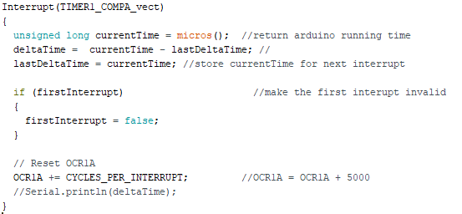
Technical Detail -Arduino Frequency Measurement
Set TCCR1B = 0b00000111; //for external clock input on T0 and rising edge detect.
Set TIMSK1 |= (1 << OIE1A ) ; // to enable timer1 interrupt
## now, OCR1A will decrement by 1 for every rising edge.
When OCR1A become zero, interrupt occurs.
Frequency = 5000/deltaTime
Send data using RadioHead library
Coding Approach :
Arduino UNO ATMega328 microcontroller equipped with 3 timer/counter registers (TCCR)
TCCR can be configured to received external clock source which can be our signal
To count the frequency, Output Comparison register (OCR) can be configured to decrement by 1 every clock cycle (cycle of our signal).
Then by measuring the time interval between each time the OCR reaches 0, we can calculate the frequency by dividing max number in OCR (255 for 8 bit) by time interval.

Slide 15
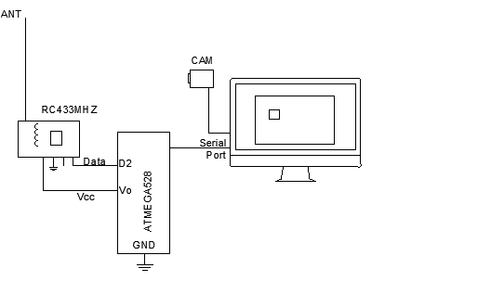
Technical Detail - Receiver Schematic

Slide 16
Object detection – Background subtraction logic flow
Open WebCam
Capture 1st Frame
Read Frequency from serial port
Capture Current Frame
contoursBox =
if(area about object size, keep, discard)
Find Contours DeltaFrame 255
DeltaFrame filtering
If(pixel < 30,0,255)
DeltaFrame = abs(1st Frame – CurFram)
While True
Is abs(cur_f-base_f) > threshold_f ?
No
Display detectBoxes[] and ContoursBox on CurFrame
Show current frame on Screen
Yes
detectBoxes[].append(contousBox)

Slide 17
Cost - Actual
2x ATMEGA528 Compatible Board 13.5
3x 433 mhz transmitter and receiver 7.95
197’ 24AWG magnet wire 7.45
Robot Car Chassis 9.99
AA battery pack 4.49
Total 43.38
Note: Cost doesn't not include circuit component (ie. Capacitor, resistor, wire) and tools (ie. Solder iron, tape, glue)

Slide 18
